Slide 1
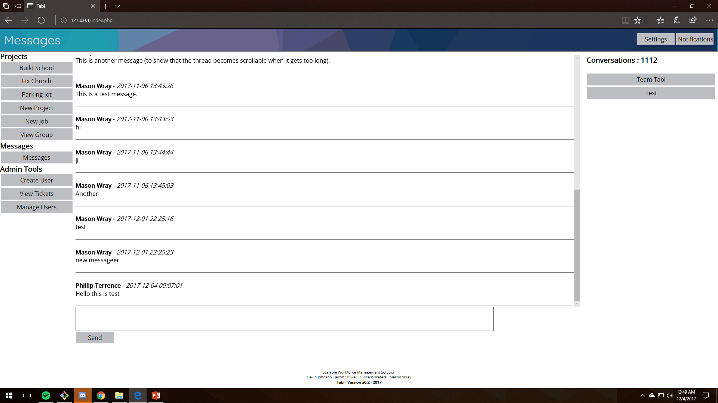
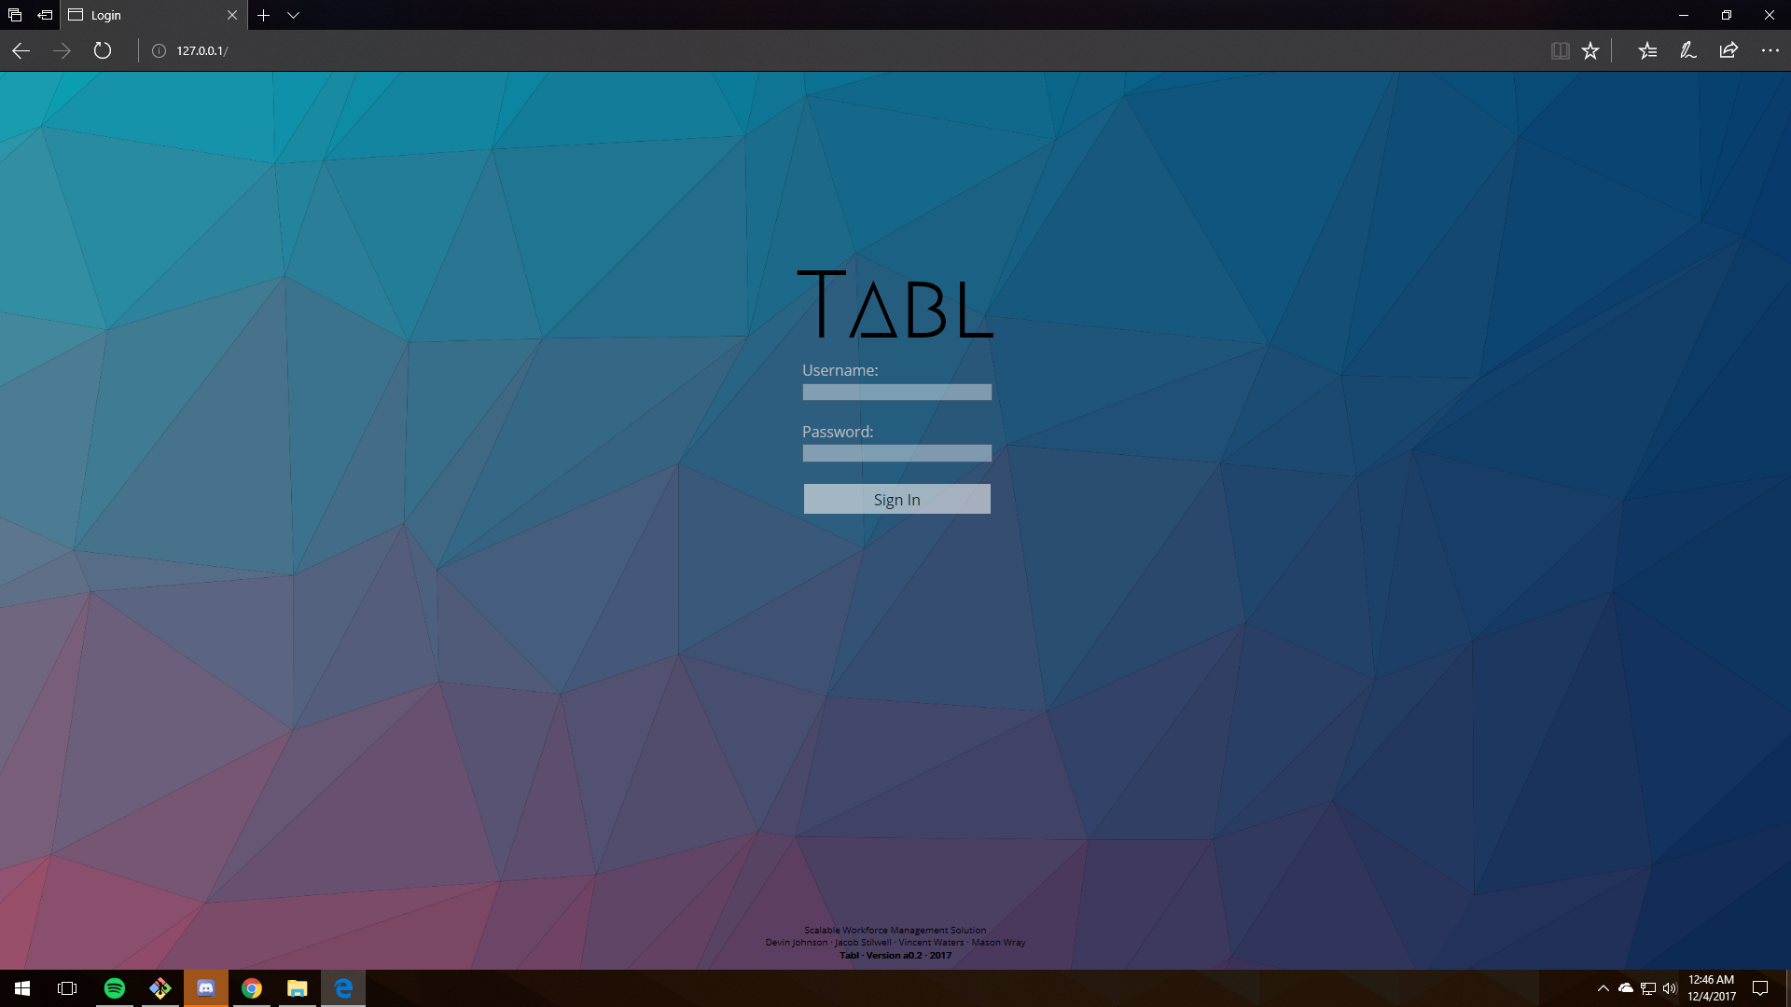
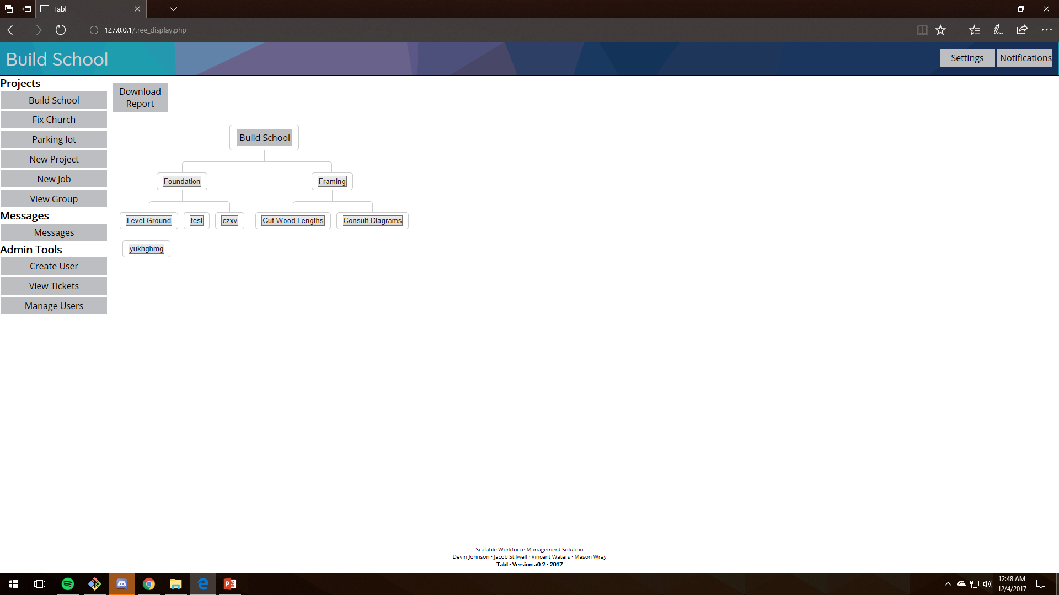
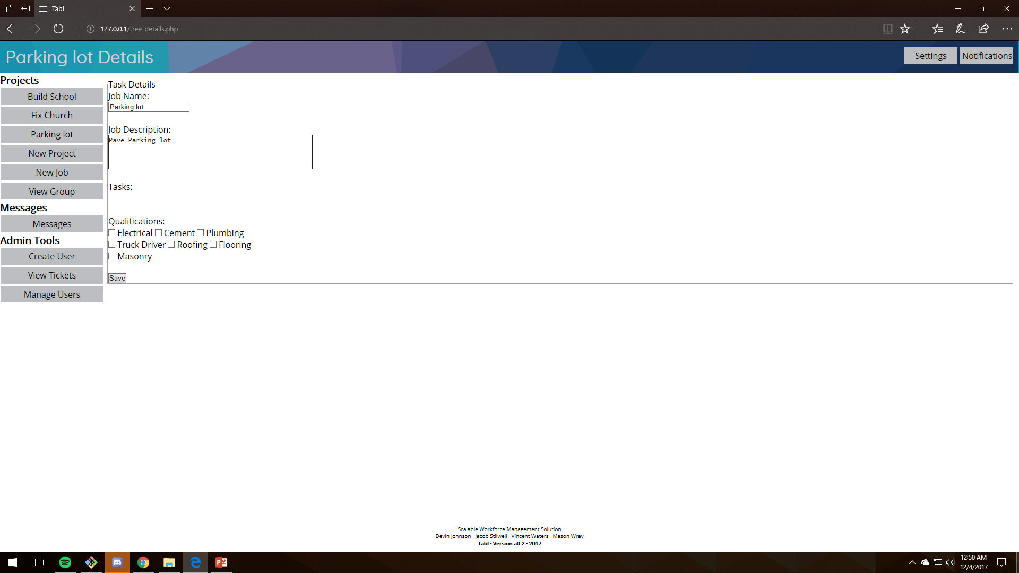
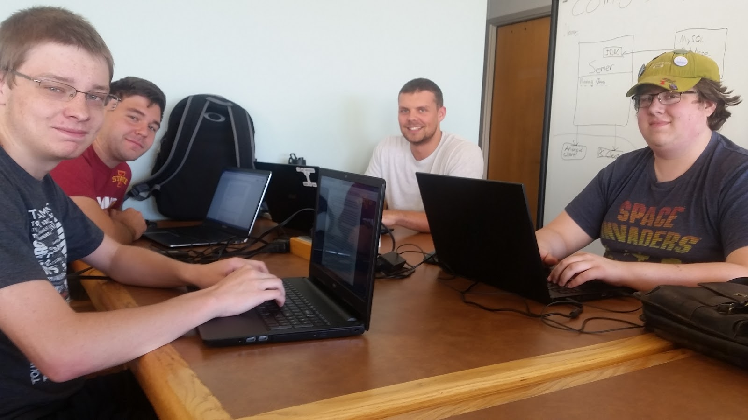
Project TABL
Devin Johnson – Jacob Stilwell – Vincent Waters – Mason Wray
CS 309 – Fall 2017
Project Description
Project TABL is a project management and workforce optimization tool. It is intended to manage and track the completion of project of any size, across multiple platforms.
Key Features Include:
Multi-platform support, as well as a web client
Integrated team messaging functionality
Intuitive tree view for task management
User Interfaces
Block Diagram
Design Decisions
Teamwork

